Slide 1

VIRTUAL MOUSE USING HAND GESTURE RECOGNITION
By KR.Sudharsna 3rd year -CSE Reg.no.:912321104045 SACS M.A.V.M.M Engineering College Madurai.

Slide 2
Outline:
Problem statement
Proposed system
System development approach
Algorithm and deployment
Result
Conclusion
Reference
2

Slide 3
Problem statement:
In traditional computer mice require physical manipulation , limiting mobility and accessibility for
users. In this project,virtual mouse aim to overcome
these limitations by providing an alternative method
of cursor control using gestures or input devices.
3

Slide 4
Proposed System:
To provide an alternative method of cursor control without a physical mouse.
Our system aims to create a virtual mouse controlled by hand gestures, making computer interaction more intuitive .
By using sensors and smart algorithms, hand movements will translate into mouse actions, offering users more flexibility.
4

Slide 5
Proposed System/Solution (cond...)
Key Components:
Gesture Recognition:
Interpret hand movements for cursor control.
Camera Integration:
Track hand movements accurately using computer cameras.
Touchpad Compatibility:
Extend functionality to touchpad-equipped devices.
Other:
Accessibility Features and Customization Options
5

Slide 6
Proposed System/Solution (contd...)
System Workflow:
Data Collection:
Sensors gather data on the hand movements continuously.
Gesture Analysis:
Algorithms process this data to figure out the gestures being made.
Mouse Actions:
Based on the gestures, the system simulates mouse actions like moving the cursor or clicking.
Feedback:
Users see these action reflected on their screens, confirming system's accuracy.
6

Slide 7
Proposed System/Solution (contd...)
Expected Outcomes:
Improved Accessibility:
Our system will make computer interaction easier for people with physical limitations.
User-Friendly:
Controlling virtual mouse will feel natural and easy, thanks to hand gestures.
Compatibility:
It will works with different computers and the software setups.
7

Slide 8
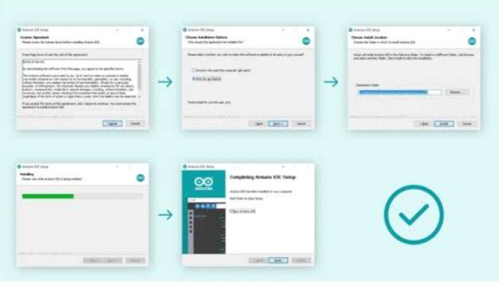
System Deployment Approach:
Development Environment Setup:
Installing the Arduino IDE
8

Slide 9
System Deployment Approach (contd...)
Hardware Requirements:
Computer with camera or touchpad is required hardware.
Software Requirements:
Gesture recognition softwares, a virtual mouse application.
Installation Process:
Simple installation process for both hardware and software components.
Compatibility:
Compatible with various operating systems(OS) and devices.
9

Slide 10
System Deployment Approach (contd...)
Install The external libraries that we will be using: pyautogui==0.9.53
opencv-python==4.5.3.56
mediapipe==0.8.6.2
comtypes==1.1.10
pycaw==20181226
screen-brightness-control==0.9.0
20

Slide 11
System Deployment Approach (contd...)
Integration:
Assemble the hardware components and connect them to microcontroller.
Upload the software code to the microcontroller and tests
virtual mouse functionality.
Fine-tune the sensitivity and accuracy of the virtual mouse through iterative testing and adjustments.
Documents the project, including schematics, code, and instructions for future reference.
10

Slide 12
System Deployment Approach (contd...)
Mouse Simulation:
Develop software modules to simulate mouse movements, clicks, and scrolling actions based on the detected hand gestures.
Testing and Optimization:
Conduct thorough testing to identify and fix any bugs or issues too.
Optimize the virtual mouse for performances, responsiveness, and accuracy.
Gathering feedback from users and make necessary improvements based on their experience.
11

Slide 13
System Deployment Approach (contd...)
User Interface:
Create a user interface for calibrating the virtual mouse and adjusting sensitivity settings.
Maintenance:
Regularly maintain the system by monitoring its perform and addressing any issues .
Keep the system up to date with a software updates and improvements to ensure optimal functionality over time.
12

Slide 14
Algorithm And Deployment
Initialize :
Start by initializing the sensors (e.g., gyroscopes and accelerometers) to capture hand movements.
Data Acquisition:
Continuously gathers data from the sensors to track hand movements.
Preprocessing:
Filter the raw sensor data to remove noise and prove accuracy.
13

Slide 15
Algorithm And Deployment (contd...)
Gesture Recognition:
Analyze preprocessed data to recognize specific hand gestures.
Identify gestures such as a pointing, clicking, dragging, scrolling based on predefined patterns (or) the machine learning models.
Mouse Action Mapping:
Map recognized gestures to corresponding mouse actions done.
Translate pointing gestures into cursor movement on the screen.
Recognize clicking gestures to perform left or right mouse clicks.
Identify scrolling gestures for vertical or horizontal scrolling.
14

Slide 16
Algorithm and Deployment (contd...)
Mouse Simulation:
Simulate the identified mouse actions based on the mapped gestures.
User Feedback:
Provide visual feedback to the user to confirm the recognized gestures and simulated mouse actions.
Adjustment and Calibration:
Allow users to adjust sensitivity settings and calibrates the system according to their preferences.
Provide a user interface for configuring parameters such as gesture sensitivity, cursor speed, and button responsiveness.
24

Slide 17
Algorithm and Deployment (contd...)
Error Handling:
Provide fallback options or prompts for users to correct errors or reinitiate gestures if necessary.
Continuous Operation:
Maintain continuous operation of the system to ensure real-time responsiveness to hand gestures.
Gracefully shutdown the system and were release any allocated resources when the user exits the virtual mouse application.
15

Slide 18
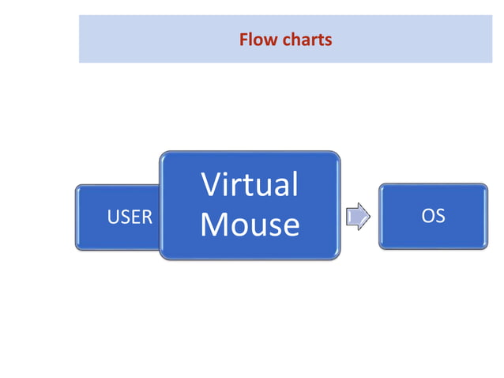
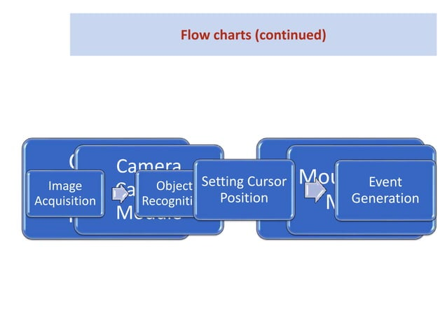
Algorithm and Deployment (contd...)
16

Slide 19
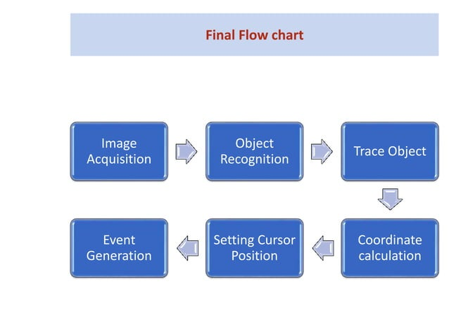
Algorithm and Deployment (contd...)
17

Slide 20
Algorithm and Deployment (contd...)
Set up hardware and software.
Test the virtual mouse functionality.
Document and deploy for use.
21

Slide 21
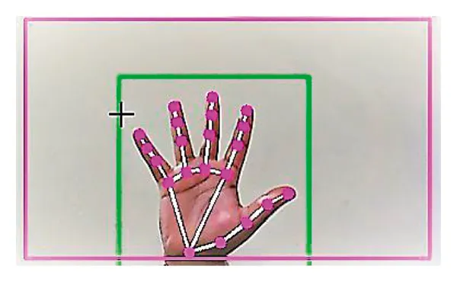
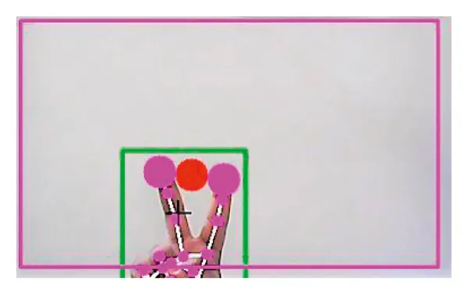
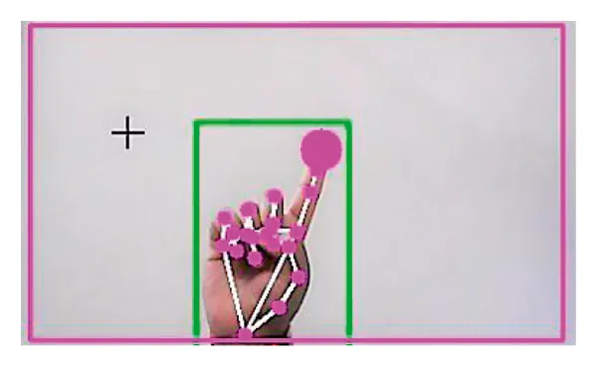
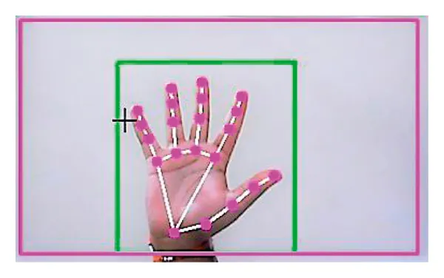
Result:
(Virtual Screen Matching) Rectangular Region for Moving through the Window
For the Mouse to Perform the Scroll down Function
Detecting Which Finger Is Up and Performing the Particular Mouse Function
For No Action to be performed on the Screen
19

Slide 22
Conclusion:
In conclusion,the virtual mouse system that they represents the significant advancement in computer interaction technology.By harnessing the power of hand gestures, we've created a user-friendly and accessible solution that eliminates the need for traditional mouse hardware.Our system not only enhances the computing experience for users of all abilities but also opens up new possibilities for intuitive and adaptable interaction.
23

Slide 23
Reference:
https://www.tensorflow.org/
https://numpy.org/
https://scikit-learn.org/stable/
https://keras.io/
https://www.kaggle.com/datasets/aryarishabh/hand-gesture-recognition-dataset
18

Slide 24

25

